Slide 1
Neural Network, Reinforcement Learning and Application
Alan Zhang
2017/03/23

Slide 2
Agenda
Basic knowledge on machine learning algo and general application field
Basic concepts of Tensorflow
Neural network model and usage in Linear Regression and Logistic Regression
Demo CNN w/ Tensorflow on MNIST dataset
Demo RNN w/ Tensorflow on MNIST dataset
Factors considering in NN usage w/ Google Demo
Basic knowledge on Reinforcement Learning
Basic algo in Reinforcement Learning
3 x Demo of Reinforcement Learning (2 x Finding Treasure, 1 x armedBandit)

Slide 3
Categories of Machine Learning and Problem Domain
Supervised Learning
Classification and Regression
Non-supervised Learning
Clustering and Reduce Dimensionality
Reinforcement Learning
Autonomous Control, Dynamic Predication etc.

Slide 4

Quote: http://scikit-learn.org/stable/tutorial/machine_learning_map/index.html

Slide 5
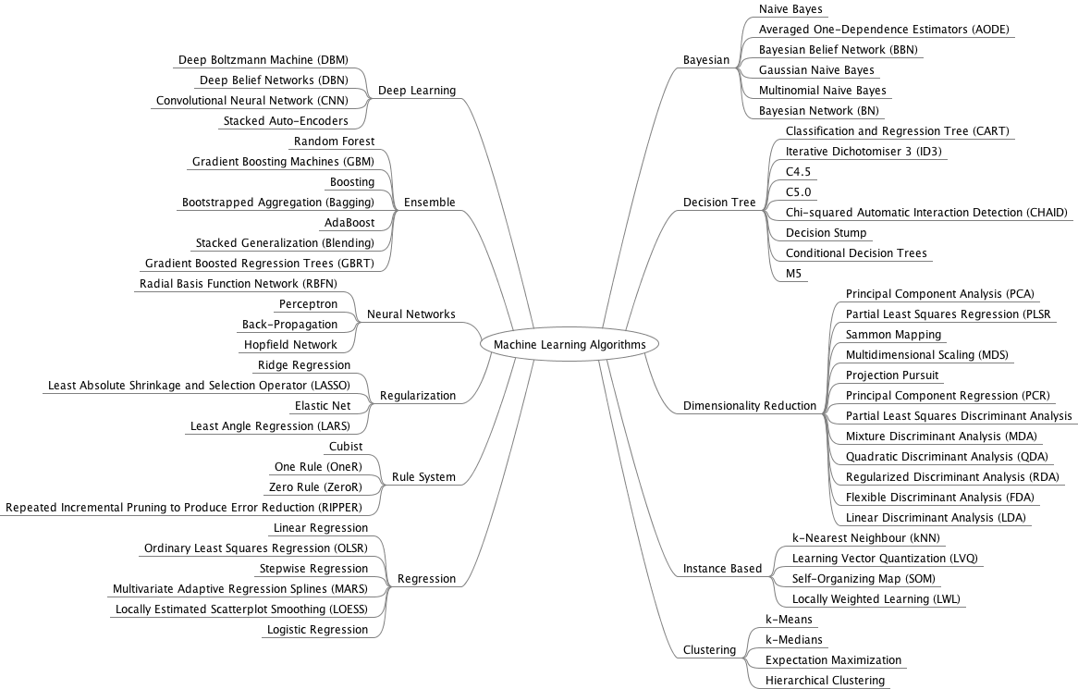
Quote: http://machinelearningmastery.com/a-tour-of-machine-learning-algorithms/

Slide 6
Popular deep learning frameworks
 | 主语言 | 从语言 | 硬件 | 分布式 | 命令式 | 声明式
Caffe | C/C++ | Python/Matlab | CPU/GPU | x | x | v
Torch | Lua | C/C++ | CPU/GPU/FPGA | x | v | x
Theano | Python | - | CPU/GPU | x | x | v
TensorFlow | Python | C++ | CPU/GPU/Mobile | v | x | v
MXNet | C++ | Python/R/Julia | CPU/GPU/Mobile | v | v | v
Quote:
https://github.com/zer0n/deepframeworks

Slide 7
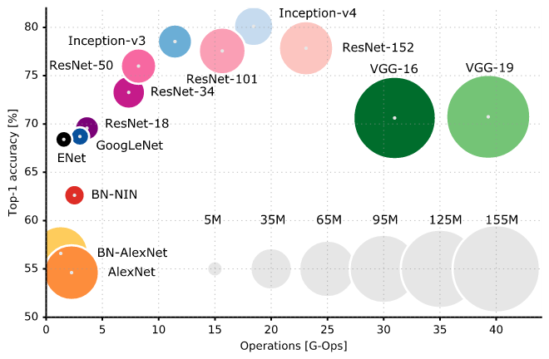

Relation between Models and Frameworks
Models like GoogLeNet, AlexNet, VGG are ConvNet architectures constructed on deep learning frameworks such as MXNet, Tensorflow, Torch etc, and their most usage are for Image Recognition, Classification, and compete in ISLVRC, what their differentiations are reflected in performance due to fine tune hardware configuration, software components layers and parameters in the deep learning frameworks.
Quote: https://arxiv.org/abs/1605.07678

Slide 8
Popular ConvNet Architectures
﻿LeNet (1990s): Already covered in this article.
1990s to 2012: In the years from late 1990s to early 2010s convolutional neural network were in incubation. As more and more data and computing power became available, tasks that convolutional neural networks could tackle became more and more interesting.
AlexNet (2012) – In 2012, Alex Krizhevsky (and others) released AlexNet which was a deeper and much wider version of the LeNet and won by a large margin the difficult ImageNet Large Scale Visual Recognition Challenge (ILSVRC) in 2012. It was a significant breakthrough with respect to the previous approaches and the current widespread application of CNNs can be attributed to this work.
ZF Net (2013) – The ILSVRC 2013 winner was a Convolutional Network from Matthew Zeiler and Rob Fergus. It became known as the ZFNet (short for Zeiler & Fergus Net). It was an improvement on AlexNet by tweaking the architecture hyperparameters.
GoogLeNet (2014) – The ILSVRC 2014 winner was a Convolutional Network from Szegedy et al. from Google. Its main contribution was the development of an Inception Module that dramatically reduced the number of parameters in the network (4M, compared to AlexNet with 60M).
VGGNet (2014) – The runner-up in ILSVRC 2014 was the network that became known as the VGGNet. Its main contribution was in showing that the depth of the network (number of layers) is a critical component for good performance.
ResNets (2015) – Residual Network developed by Kaiming He (and others) was the winner of ILSVRC 2015. ResNets are currently by far state of the art Convolutional Neural Network models and are the default choice for using ConvNets in practice (as of May 2016).
DenseNet (August 2016) – Recently published by Gao Huang (and others), the Densely Connected Convolutional Network has each layer directly connected to every other layer in a feed-forward fashion. The DenseNet has been shown to obtain significant improvements over previous state-of-the-art architectures on five highly competitive object recognition benchmark tasks. Check out the Torch implementation here.

Slide 9
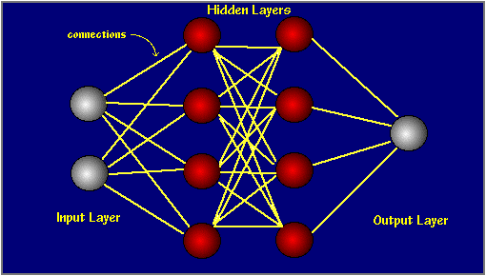
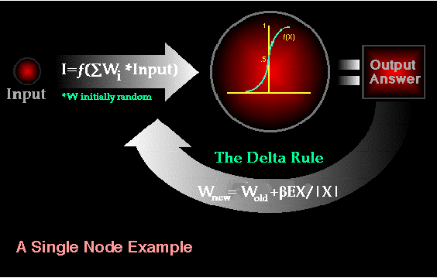
Neural Network and Neuron
Three key elements consisting of neuron: Weight, Bias, Activation Function, whereas Weight and Bias can be automatically tuned during training process via backpropagation algorithm;
Activation Function: Softmax, Sigmoid, Tanh, and ReLU have been experienced in specific field applications. Softmax is used in output layer to convert one K-dimensional vector of any real values to anther K-dimensional vector of real value range (0, 1).

Slide 10
General method of using neural network
Extract the major features of training data (data source can be divided into training dataset and test dataset) via Autoencoder and Clustering processing, Both Autoencoder and Clustering is Non-surprised learning process in Dimensionality Reduction, and highlight Density Distribution, and normalize the input format to the input layer of the designated neural network;
Set up layers of the designated neural network, and assign random Weights & Biases for each nodes inside every layers, and Activation function such as Sigmoid, ReLU, Tanh etc.;
Define Loss function such as Square Loss for Linear Regression, Cross-entropy Loss for Logic Regression (i.e. Classifier), Hinge Loss for Support Vector Machine (SVM) etc.;
Set up training model of the designated neural network, i.e. specify Optimizer function such as SGD, Momentum, NAG, Adagrad, Adadelta, Rmsprop etc; (Quota:https://www.tensorflow.org/api_docs/python/tf/train)
Enter training loop and output Loss value during epochs, then run verification with test dataset, output the accuracy based on trained parameters.

Slide 11

Basic knowledge on Tensorflow
Key concepts in Tensorflow
TensorFlow: is a programming system in which you represent computations as graphs in which the nodes represents math operations.
Tensor: an n-dimensional array or list. Only tensors may be passed between nodes in the computation graph.
Session: Sessions contain "computational graphs" that represent calculations to be carried out.
Placeholder: An interface between a computational graph element and your data. Placeholder can present input or output.
The defined "Graph Model" will be processed by the TensorFlow engine when Session.run() is called.
TensorFlow can support graphic view of computing structure that can help to deploy computations to several CPUs/GPUs.
https://www.tensorflow.org/images/tensors_flowing.gif

Slide 12
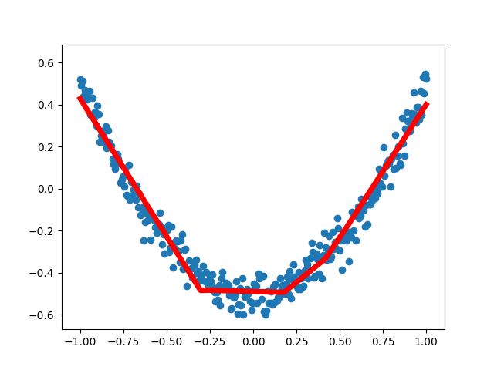
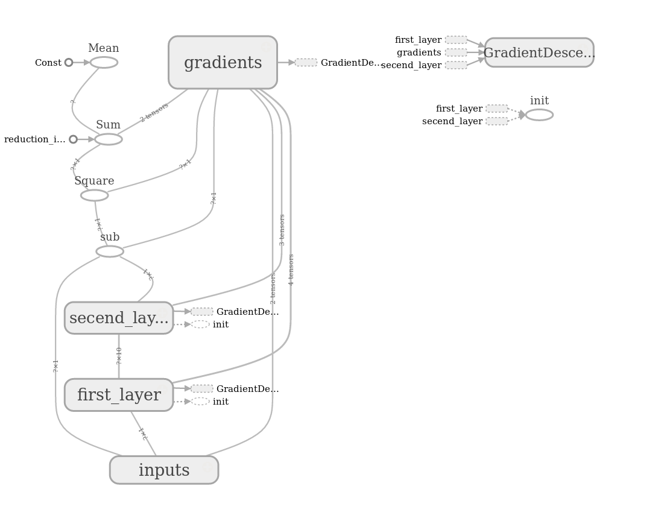
Using Tensorflow on Linear Regression
test4tf_demoTensorBoard.py

Slide 13
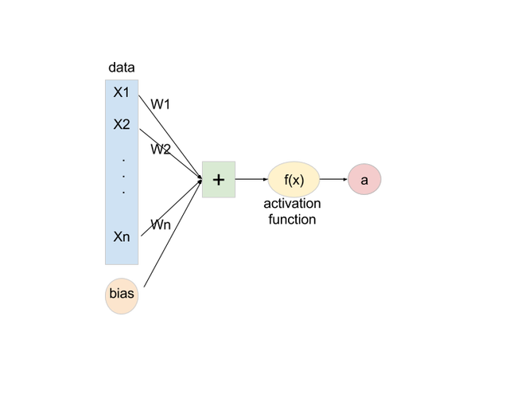
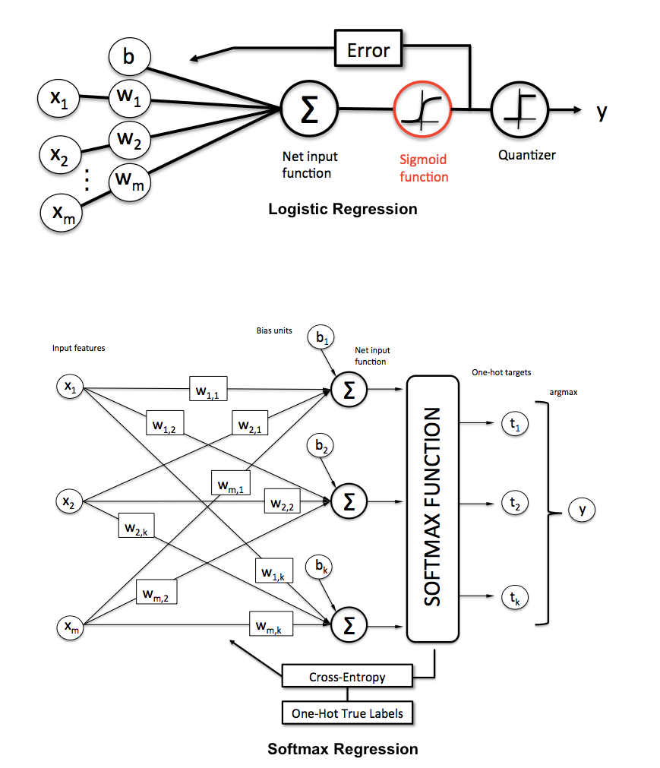
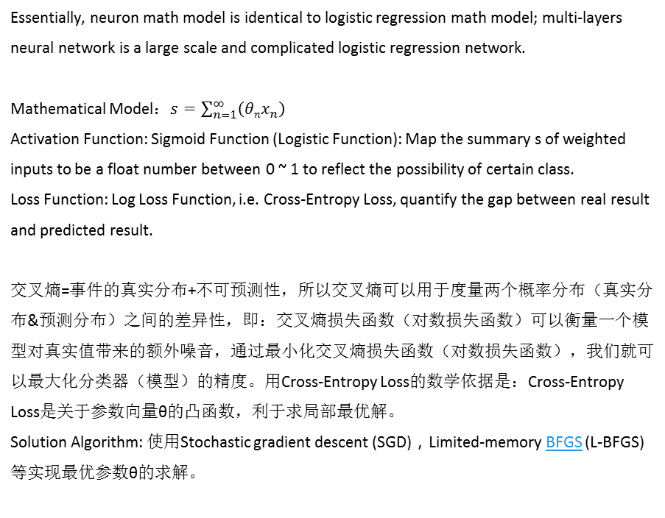
Using Tensorflow on Logistic Regression
Essentially, neuron math model is identical to logistic regression math model﻿; multi-layers neural network is a large scale and complicated logistic regression network.
Mathematical Model：$s=\sum_{n=1}^{∞}{\left({θnx}_{n}\right)}$
Activation Function: Sigmoid Function (Logistic Function): Map the summary s of weighted inputs to be a float number between 0 ~ 1 to reflect the possibility of certain class.
Loss Function: Log Loss Function, i.e. Cross-Entropy Loss, quantify the gap between real result and predicted result.
﻿交叉熵=事件的真实分布+不可预测性，所以交叉熵可以用于度量两个概率分布（真实分布&预测分布）之间的差异性，即：交叉熵损失函数（对数损失函数）可以衡量一个模型对真实值带来的额外噪音，通过最小化交叉熵损失函数（对数损失函数），我们就可以最大化分类器（模型）的精度。用Cross-Entropy Loss的数学依据是：Cross-Entropy Loss是关于参数向量θ的凸函数，利于求局部最优解。
Solution Algorithm: ﻿使用Stochastic gradient descent (SGD)，Limited-memory BFGS (L-BFGS)等实现最优参数θ的求解。

Slide 14
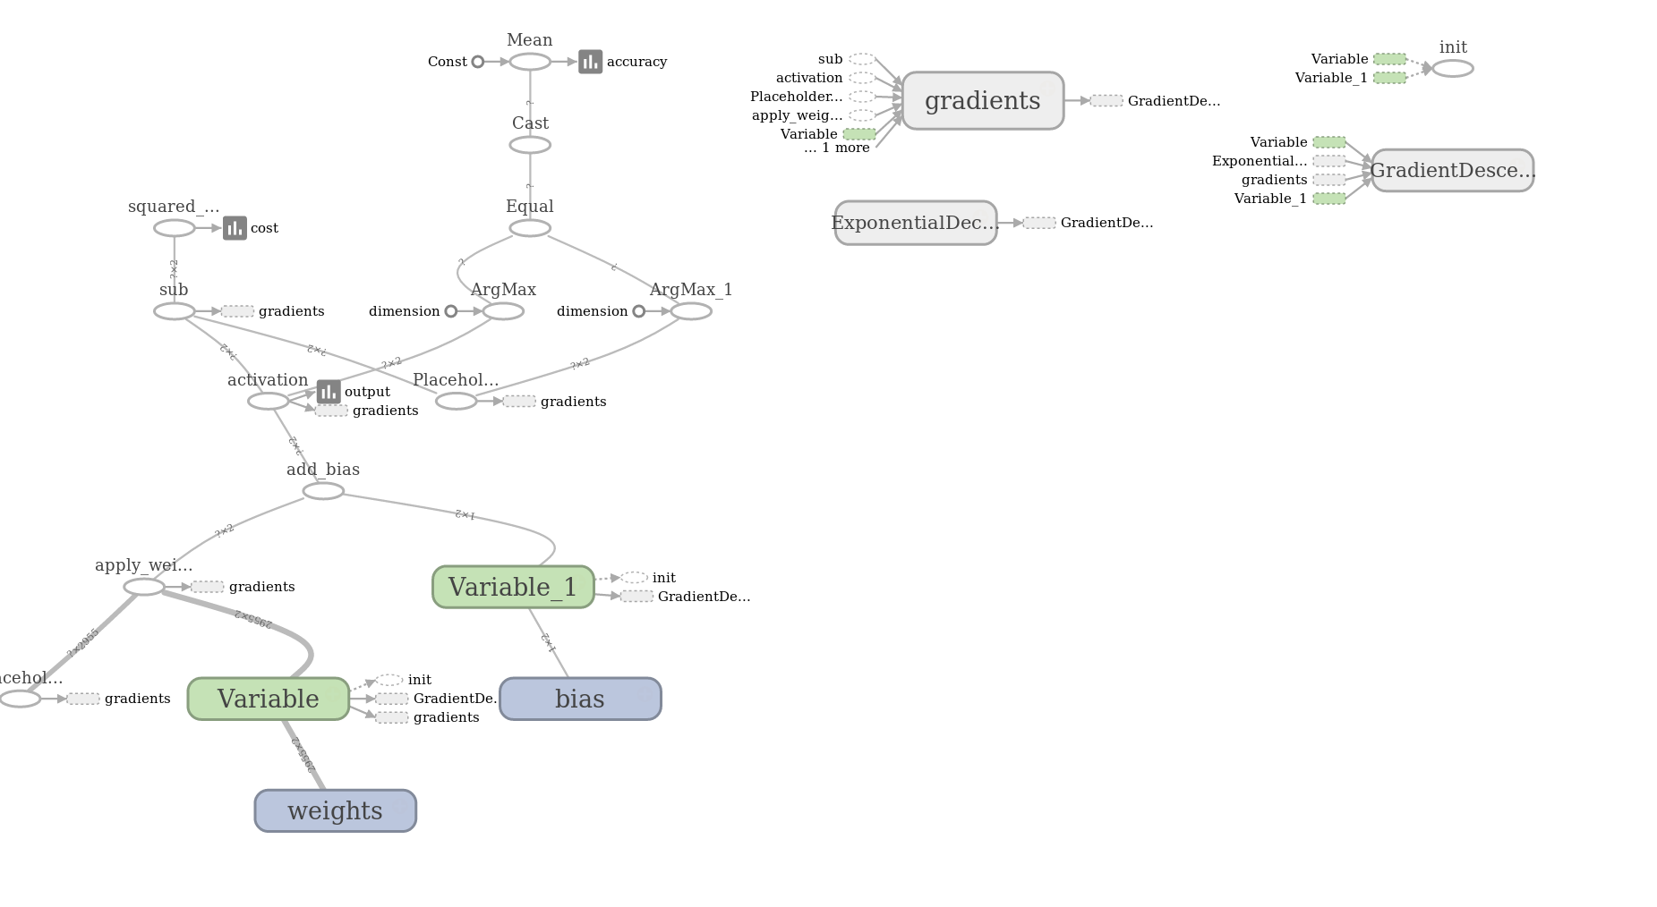
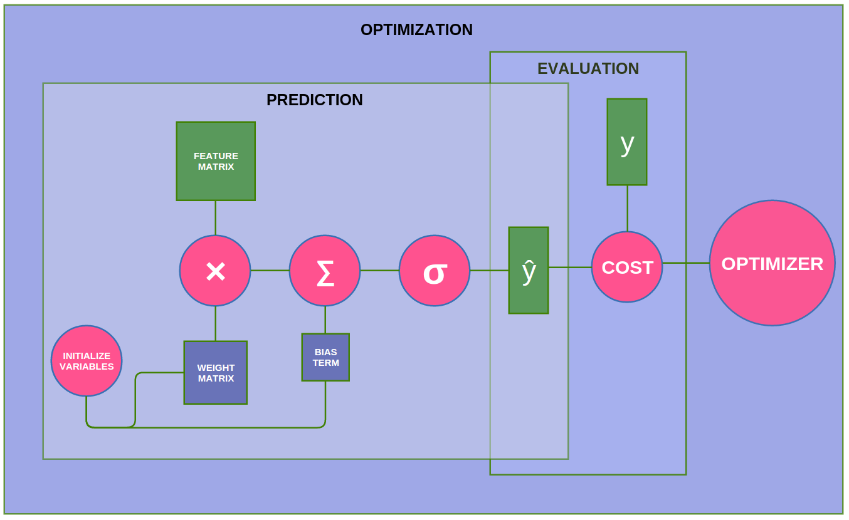
Using Tensorflow on Logistic Regression
Example: Email classification
The left diagram shows the computing graph of logistic_regression_train.py and logistic_regression_predict.py.
Quote: http://jrmeyer.github.io/tutorial/2016/02/01/TensorFlow-Tutorial.html

Slide 15
CNN for MNIST
Convolutional neural networks (CNNs) are the current state-of-the-art model architecture for image classification tasks. CNN contains 3 components:
Convolution Layers, ﻿which apply a specified number of convolution filters (alias name: Filter, Kernel, Feature Detector) such as “Identity”, “Edge Detect”, “Sharpen”, “Box Blur”, “Gaussian Blur” to the image, ﻿to produce a single value in the output feature map (alias name: Convolve Feature, Activation Map). Convolutional layers then typically apply a ReLU activation function to the output to introduce nonlinearities into the model.
Pooling Layer, ﻿which downsample the image data extracted by the convolutional layers to reduce the dimensionality of the feature map in order to decrease processing time.
Dense (Fully connected) Layer, ﻿which perform classification on the features extracted by the convolutional layers and down-sampled by the pooling layers.
(n^{th}_sample, 28 x 28, 1 channel) → [5 x 5 pitch (conv filter/kernel)]_{32 neuron} → [2 x 2 Max Pooling]_{32 neuron} → (n^{th}_sample, 14 x 14, 1 channel)_{32 neuron}→ [5 x 5 pitch (conv filter/kernel)]_{64 neuron} → 2 x 2 Max Pooling → (n^{th}_sample, 7 x 7, 1 channel)64 neuron → (FCL_1 output 1024 1-D data)_{7 x 7 x 64 neuron} → (FCL_2 output 10 1-D data)_{1024 neuron} → Softmax output
Example: test4tf_cnn.py
Quote: https://www.tensorflow.org/versions/master/tutorials/layers/
http://robromijnders.github.io/tensorflow_basic/
https://ujjwalkarn.me/2016/08/11/intuitive-explanation-convnets/

Slide 16



RNN for MNIST
LSTM RNN Module: Gating, Mux, Update, Output Decision, 4 neural network layers.
Demo: test4tf_rnn.py
Reference and Quote:
http://karpathy.github.io/2015/05/21/rnn-effectiveness/
http://colah.github.io/posts/2015-08-Understanding-LSTMs/

Slide 17
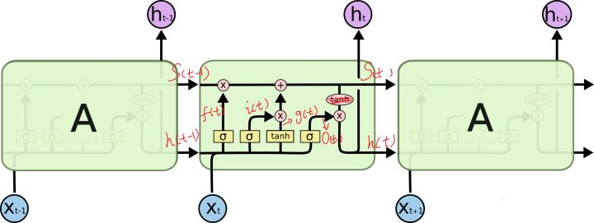
LSTM Model Description
cell 里面有四个黄色小框，你如果理解了那个代表的含义一切就明白了，每一个小黄框代表一个前馈网络层，num_units就是这个层的隐藏神经元个数，其中1、2、4的激活函数是 sigmoid，第三个的激活函数是 tanh。
1、 cell 的状态是一个向量，是有多个值的
2、 上一次的状态 h(t-1)是和下一次的输入 x(t) 结合（concat）起来的，把二者直接拼起来，比如 x是28位的向量，h(t-1)是128位的，那么拼起来就是156位的向量
3、 cell 的权重是共享的，
4、一层的 LSTM 的参数有多少个？假设 num_units 是128，输入是28位的，四个小黄框的参数一共有 （128 + 28）*（128 * 4），其中128 x 4是四个神经元层中神经元的单元个数，(128 + 28)是每个神经元要处理的输入个数，所以总共是156 * 512参数，中间层的参数就是这样，不过还要加上输出的时候的激活函数的参数，假设是10个类的话，就是128*10的 W 参数和10个bias 参数。
5、cell 最上面的一条线的状态即 s(t) 代表了长时记忆，而下面的 h(t)则代表了工作记忆或短时记忆。

Slide 18

Factors considering in NN implementation
For neuron:
Activation Function: Sigmoid, Tanh, ReLU, Softmax (for output);
Weight & Bias: adjusted automatically during training process.
For NN:
Over-fitting: Adjust neuron output drop-out probability to simulate real human neuron behavior;
Learning rate: Referenced by Optimizer algo that instruct how fast the weight of neuron can be evolved. Setting high may miss the most optimized result, setting low may cause optimizer take long time to search optimized result. A general practical guide to decay Learning Rate by 0.5 ratio every 30~50 epochs.
ConvFilter: Pitch size, Stride, Max/Average Pool
Optimizer algo: Refer to https://www.tensorflow.org/api_guides/python/train to see what optimizer algo can support
For data samples:
Normalization: If the input dataset span in big range or small range that may cause activation function output enter saturating area, please refer to https://www.tensorflow.org/versions/r0.12/api_docs/python/nn/normalization to understand what normalization algo can support.
Quote: Animation credit: Alec Radford
Demo: ﻿A Neural Network Playground

Slide 19
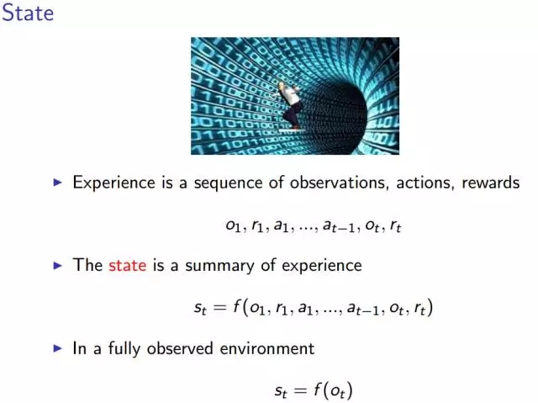
Reinforcement Learning Concept Model Reference: http://sports.sina.com.cn/go/2017-03-25/doc-ifycstww1083825.shtml
状态是所有经历（experience）的总和，经历就是上图中的第一个序列函数。某时刻 t 的状态 st 是该时刻以及之前所有时刻的所有观测量、奖励以及动作序列的函数。但是，当代理所处的环境具有一种我们所说的完全可观测性之后，就有了上图中的第二个状态函数——某时刻的状态仅仅是该时刻的观测值 Ot 的函数，这样一来，整个经历似乎具备了某种类似于马尔可夫性的性质。
然后，就有了三个新的想法：策略（policy）、价值函数（value function）和模型（model）.

Slide 20
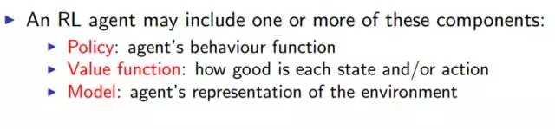
Major Component of an RL Agent
一个强化学习的代理可能包含一个或多个下述的组成：
策略：代理的行为函数
价值函数 （Value function）：评价一个状态或者行为的好坏及其程度
模型（Model）：代理对环境的表征
策略指的是代理的行为，它是从状态到行为的映射。包括确定策略和随机策略。
确定策略：a =π（s）
随机策略：π（a|s）= P[a|s]

Slide 21
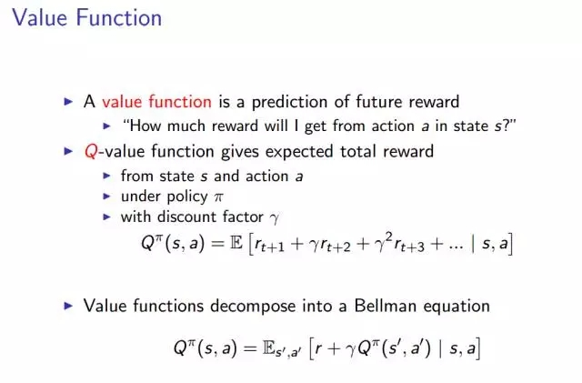
Value Function
Q 价值函数表示奖励总值的期望。表示在给定一个策略π，贴现因子γ，和状态 s 下，执行动作 a，获得奖励的综合的期望是多少？
Q 价值函数还能够分解为上图描述的贝尔曼方程。

Slide 22
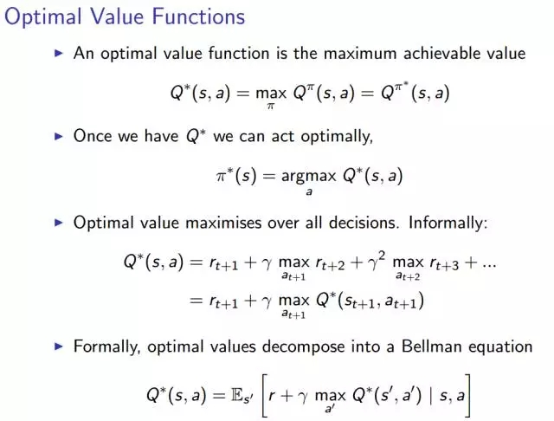
Optimal Value Functions
优化价值函数就是使得价值函数达到可实现的最大值。以此为条件就会得到整个问题的最优解，以及相应的最优策略π*。

Slide 23
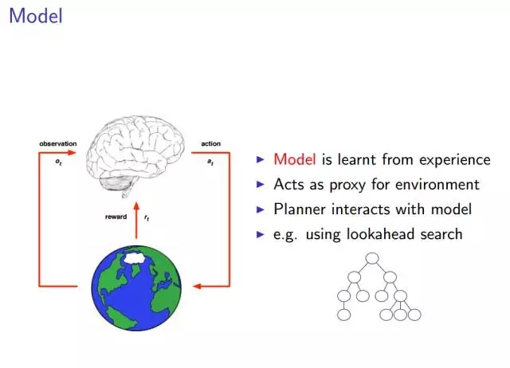
Model in RL

Slide 24
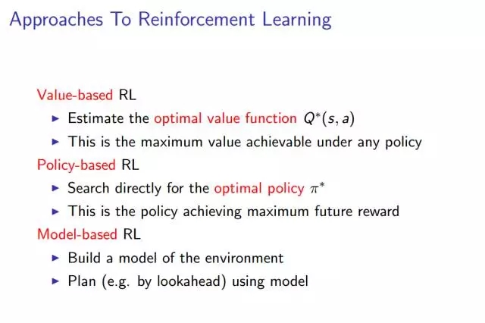
Approaches to RL
有三种实现强化学习的途径，分别基于不同的原则。即：基于价值的强化学习，基于策略的强化学习，以及基于模型的强化学习。
基于价值的强化学习，需要估计 Q 价值函数的最大值 Q*，这是在任意策略下能够得到的最大 Q 价值函数。
基于策略的强化学习，直接搜索最佳的策略π*，这将得到能够最大化未来奖励的策略π*。
基于模型的强化学习，构建一个环境的模型，用模型进行诸如前向搜索的规划。

Slide 25
深度强化学习（Deep Reinforcement Learning）
将强化学习和深度学习结合在一起，我们寻求一个能够解决任何人类级别任务的代理。强化学习定义了优化的目标，深度学习给出了运行机制——表征问题的方式以及解决问题的方式。
用深度神经网络来代表
* 价值函数
* 策略
* 模型
用随机梯度下降来优化损失函数

Slide 26
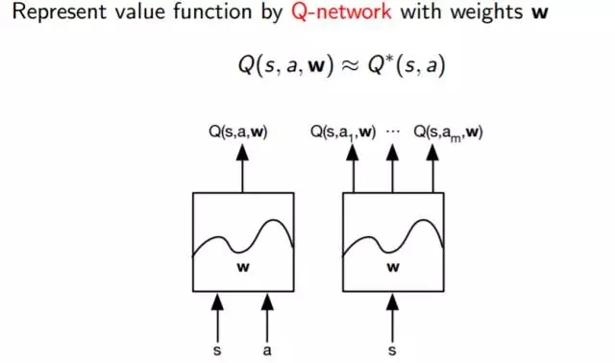
基于价值的深度强化学习
基于价值的深度强化学习的基本思想就是建立一个价值函数的表示，我们称之为 Q 函数。
其中：
s =状态
a =动作
w =权值
正如我们在上边图片中看到的一样，基本上就是一个黑盒子，将状态和动作作为输入，并输出 Q 和一些权值参数。

Slide 27
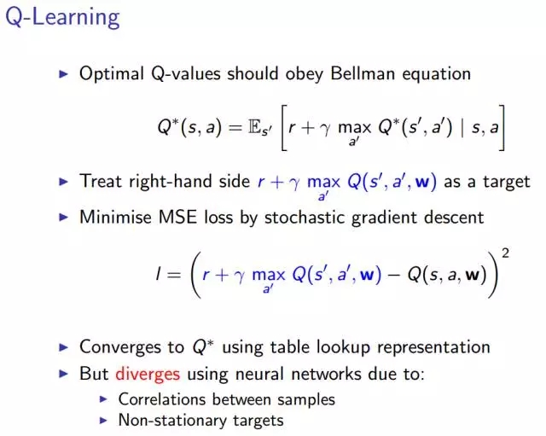
基于价值的深度强化学习
等号右边作为优化的目标。现在逐步解释这个算法：将左侧的内容移到等号右边。
随后我们用随机梯度下降的方法去最小化最小均方差 （MSE），一般这个方法在优化的过程中都会奏效的。如果每一个状态和动作都有一个单独的值，那么在这个方法下，价值函数会收敛到一个最优值。不幸的是，由于我们使用的是神经网络，会有两个问题出现：
采样之间的相关性：加入我是一个四处走动的机器人，通过实际数据来学习。我将算法中的每一步视为采取行动的状态，如此一来，这些状态和动作就会和上一次执行的动作非常接近。也就是说，我们采取的方法中存在很强的相关性。
我们从中学习到的目标依赖于目标本身，因此这些都是非平稳的动态。正是由于非平稳动态的存在，我们的近似函数会螺旋式失控，并且导致我们的算法崩溃。

Slide 28
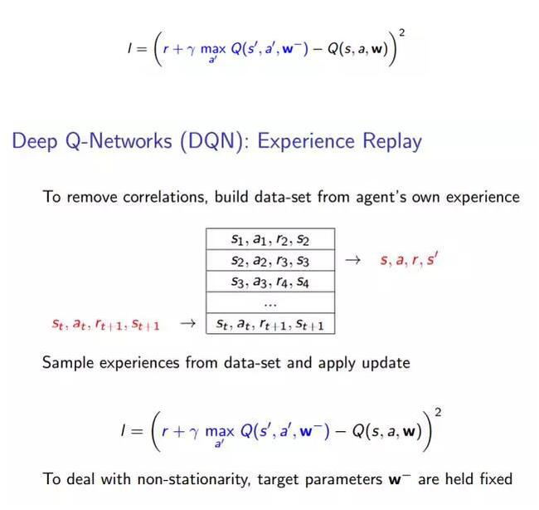
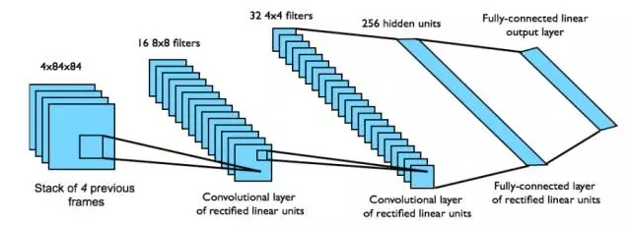
基于价值的深度强化学习
为了实现稳定的深度强化学习，我们引入的第一个方法是被称为 DQN 的深度强化网络。
Atari 中的 DQN
从状态 s 中端对端地学习 Q 价值函数Q（s，a）。
输入状态 s 是最近 4 帧的原始像素组成的堆栈
输出的 Q 价值函数 Q（s，a） 用于 18个操纵杆/按钮的位置
奖励就是每一步动作所对应的得分的变化

Slide 29
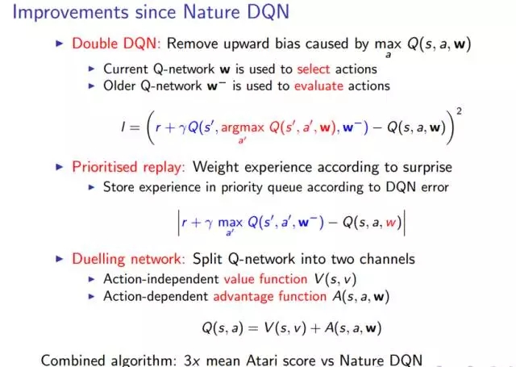
基于价值的深度强化学习
双深度 Q 网络（Double DQN）: 两个深度 Q 网络把评价动作的方式分解为两个路径。一个深度 Q 网络用来选择动作，另一个用来评价动作，这在实践中确实很有帮助。

Slide 30
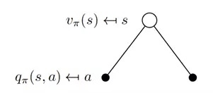
Key Concept in Reinforcement Learning
Differing from other machine learning algorithms that are used to process input data set, and draw out major features for classification, regression, clustering, and reduce dimensionality, Reinforcement Learning is used to perform autonomous control and dynamic forecast in return way to outside world (i.e. environment).
Roles in Reinforcement Learning
Agent: the actor;
Environment: the set of system state.
Major Character of Reinforcement Learning
“Trail-and-Error” to find out the optimized Policies to bring about best/optimized accumulated Reward. Policy is the map between State and Action, generally, it should be a possibility of certain action ‘a’ under certain state ‘s’;
Delay Reward, the future reward is estimated by stochastic evaluation of future executing policies described in Action-Value function (i.e. Table);
Discrete time, discrete observations, and discrete actions.
Training Method
Iterate Policy and State with State-Reward to evolve State-Value function, and Action-State Value function to get max value of Action-State Value function under any initial state;
State-Reward defines the rule of game, i.e. system of reward and penalty; Q-Table (the result of evolved State-Value function, and Action-State Value function) is the intelligence of Agent.
Relation between State-Value function Action-State Value function

Slide 31
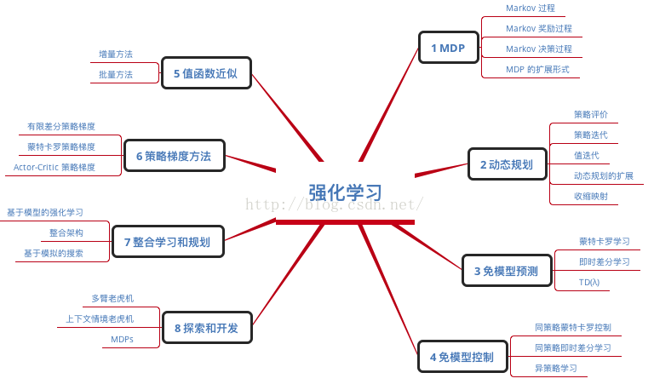
Reinforcement Learning Algorithm Map
Quote: http://blog.csdn.net/ikerpeng/article/details/53031551

Slide 32
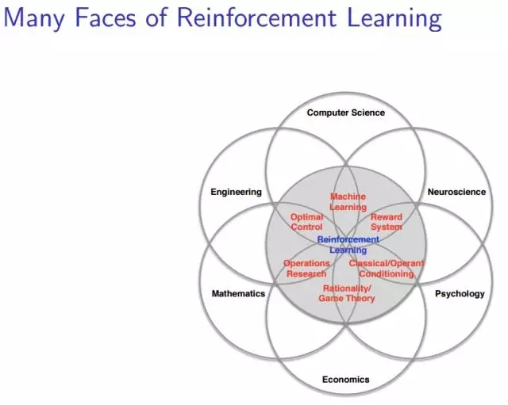
Reinforcement Learning Application Scenerio

Slide 33
Most Used Algorithms in Reinforcement Learning
Dynamic Programming method
Fully model-based (reward function, state transition probabilities, and fixed policy), execute policy iteration in policy evaluation and improvement;
Traverse for full possibilities to get State-Value and Q-Function, update per step (online mode).
Monte Carlo method
Model-free, learning from samples and calculate an approximate optimized Q-Function for a specific state independently, episode-based (batch mode).
Temporal Difference method
Step-based update (online mode), model-free.
Q-Learning (Demo: test4tf_qLearning.py, test4qLearningRun.py, test4n_armedBanditProblem.py)
Sarsa
Reference & Quote Resources:
https://github.com/stone8oy/deepRL/tree/resource
﻿Reinforcement Learning-An Introduction
﻿Algorithms for Reinforcement Learning
﻿Reinforcement Learning State-of-the-Art
﻿Recent Advances in Reinforcement Learning

Slide 34
Inception Module
Background
Inception Module architecture allows the model to recover both local feature via smaller convolutions and high abstracted features with larger convolutions

Slide 35
Backup
Remove all packages marked as rc by dpkg
$ dpkg --list |grep "^rc"
rc bsh 2.0b4-10ubuntu2 Java scripting environment (BeanShell) Versi
rc devicekit-disks 007-2ubuntu6 abstraction for enumerating block devices
rc devicekit-power 011-1ubuntu2 abstraction for power management
rc dvipdfmx 1:20090115-1.2 A DVI to PDF translator with CJK support
rc gnome-blackjack 1:2.28.0-0ubuntu3 Blackjack casino card game
rc groovy 1.6.4-4ubuntu2 Agile dynamic language for the Java Virtual
rc kdepim-runtime-data 4:4.3.2-0ubuntu1 shared data files for the KDE 4 base runtime
$ dpkg --list |grep "^rc" | cut -d " " -f 3
bsh
devicekit-disks
devicekit-power
dvipdfmx
gnome-blackjack
groovy
kdepim-runtime-data
$ dpkg --list |grep "^rc" | cut -d " " -f 3 | xargs sudo dpkg --purge
[sudo] password for abcde:
(Reading database ... 239389 files and directories currently installed.)
Removing bsh ...
Purging configuration files for bsh ...
Removing devicekit-disks ...
Purging configuration files for devicekit-disks ...
Removing devicekit-power ...
Purging configuration files for devicekit-power ...
dpkg: warning: while removing devicekit-power, directory '/var/lib/DeviceKit-power' not empty so not removed.
Removing dvipdfmx ...
Purging configuration files for dvipdfmx ...
Removing gnome-blackjack ...
Purging configuration files for gnome-blackjack ...
Removing groovy ...
Purging configuration files for groovy ...
Removing kdepim-runtime-data ...
Purging configuration files for kdepim-runtime-data ...
Removing kdepim-runtime-libs4 ...

Slide 36
IPython Notebook的介绍 Reference: http://www.cnblogs.com/zhuangzhuang1988/archive/2012/11/19/2777195.html
使用
ipython notebook
Tips
MarkDown to write comments
如果在函数、模块、类后面输入‘?’，按住Ctrl-Entry的话就回跳出帮助文档。
在网页中输入%matplotlib inline将matplotlib库导入，要显示的图片就可以嵌入到网页中了
使用ipython nbconvert [.ipynb文件]命令来生成默认格式(html格式)
还可以使用--to选项来转换为指定的格式，如：
ipython nbconvert --to latex mynotebook.ipynb
%load可以从文件或者网址载入代码到一个新的单元中，例如下面载入某个matplotlib的示例程序，并执行
%load http://matplotlib.org/mpl_examples/pylab_examples/histogram_demo.py
%prun用于代码的执行性能分析，可以作为行命令和单元命令使用

Slide 37
Download Sites:
https://github.com/alanz2015/Machine-Learning-Study-Notes
http://wubaoguo.com/2016/01/11/%E7%89%88%E6%9C%AC%E6%8E%A7%E5%88%B6/Git%E5%85%A8%E8%A7%A3%E6%9E%90%E4%B9%8B%E8%BF%9C%E7%A8%8B%E4%BB%93%E5%BA%93%E4%BA%A4%E4%BA%92/
https://github.com/geeeeeeeeek/git-recipes/wiki/5.2-%E4%BB%A3%E7%A0%81%E5%9B%9E%E6%BB%9A%EF%BC%9AReset%E3%80%81Checkout%E3%80%81Revert-%E7%9A%84%E9%80%89%E6%8B%A9
git init
echo "# MyQuantitativeAlgoTest" >> README.md
git add README.md
git commit -m "First commit"
git remote add origin https://github.com/alanz2015/MyQuantitativeAlgoTest.git
git push -u origin master
﻿origin为远程仓库引用的别名，此名称可以修改，也可以有多个，
可以参考git remote命令了解更多
git push origin master
origin指定了你要push到哪个remote,master其实是一个“refspec”，
正常的“refspec”的形式为”+<src>:<dst>”，冒号前表示local branch的名字，
冒号后表示remote repository下 branch的名字。Ex.
$git push origin master:master
$git push origin master
$git push origin master:refs/for/mybranch
$git push origin HEAD:refs/for/mybranch
$git push origin :mybranch （再origin repository里面查找mybranch，
删除它。用一个空的去更新它，就相当于删除了）
BKM to fix Python upgrade version from 2.7.x to 3.5.x
﻿
sudo apt-get clean
sudo apt-get update
sudo apt-get install --reinstall python-minimal python-lockfile
sudo update-alternatives --install ... python-2.7
sudo update-alternatives --install ... python-3.5
sudo update-alternatives --config python
python -V
sudo apt-get purge python-pip
sudo -E python ~/bin/git-pip.py
sudo apt-get install python3-dev
sudo pip --proxy ... install TA-Lib QTPyLib
cd ~/workspace/tushare
sudo python ./setup.py install
sudo pip install --proxy http://proxy-us.intel.com:911 --upgrade …..

Slide 38
什么是量化投资 https://bigquant.com/docs/exchange_markets.html https://www.joinquant.com/post/585 https://www.ricequant.com/community/topic/174//22?page=2 https://pypi.python.org/pypi/QTPyLib http://mrjbq7.github.io/ta-lib/funcs.html https://www.ricequant.com/api/python/chn#data-method-get_split http://blog.csdn.net/niuge8905/article/details/78287355
量化投资是指通过数量化模型建立科学投资体系，以获取稳定收益。
量化投资的有哪些优势
纪律性：严格执行投资策略，不是投资者情绪的变化而随意更改。这样可以克服人性的弱点，如贪婪、恐惧、侥幸心理，也可以克服认知偏差。
系统性：量化投资的系统性特征包括多层次的量化模型、多角度的观察及海量数据的观察等。多层次模型包括大类资产配置模型、行业选择模型、精选个股模型等。多角度观察主要包括对宏观周期、市场结构、估值、成长、盈利质量、市场情绪等多个角度分析。此外，海量数据的处理能力能够更好地在广大的资本市场捕捉到更多的投资机会，拓展更大的投资机会。
及时性：及时快速地跟踪市场变化，不断发现能够提供超额收益的新的统计模型，寻找新的交易机会。
准确性：准确客观评价交易机会，克服主观情绪偏差，从而盈利。
分散化：在控制风险的条件下，量化投资可以充当分散化投资的工具。表现为两个方面：一是量化投资不断地从历史中挖掘有望在未来重复的历史规律并且加以利用，这些历史规律都是较大概率取胜的策略；二是依靠筛选出股票组合来取胜，而不是一只或几只股票取胜，从投资组合的理念来看也是捕捉大概率获胜的股票，而不是押宝到单个股票。

Slide 39
如何进行量化投资
使用量化策略是进行量化投资的有效方式。
通过客观准确的交易规则构建策略，并在历史数据上进行回测，当回测结果通过评估审核后才可以称得上是一个可进行实盘交易的量化策略，许多私募在实盘之前还有一个模拟交易阶段。
小结：量化投资是指通过数量化模型建立科学投资体系，以获取稳定收益。与传统投资方式不同的是，量化投资更加注重模型的应用，其优势在于纪律性、系统性、及时性、准确性和分散化。使用量化策略是进行量化投资的有效方式。

Slide 40
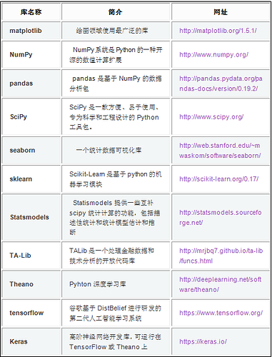
什么是策略生成器
量化策略的开发一般离不开编写代码，BigQuant平台使用的策略开发语言为Python，如果会写代码，那么策略开发上手就比较快。为了满足一些编程基础薄弱的用户能够快速上手，因此推出了策略生成器这一大“神器”。通过策略生成器，你可以通过菜单化操作来一键生成策略代码。

Slide 41
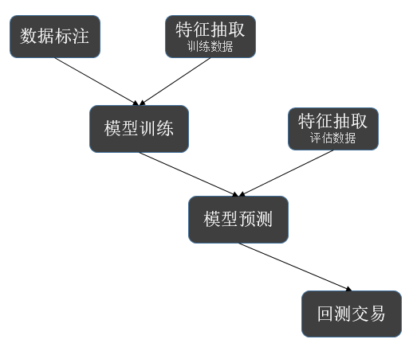
量化投资中的AI策略
基础配置
start_date 和 end_date 确定了我们要用数据段 其中 [start_date, split_date) 区间的数据，用于模型训练 [split_date, end_date] 区间的数据，用户模型回测
instruments：股票池，D.instruments123(start_date, split_date) 取A股给定时间段内所有出现过的股票。
label_expr，用户标注的函数，更多说明见下面关于 M.advanced_auto_labeler的介绍。
hold_days：持仓时间，用于数据标注和回测，具体见下面相关模块使用
features：特征 (因子)，具体见下面相关模块使用

Slide 42
量化投资中的AI策略 https://community.bigquant.com/t/BigQuant-AI%E7%AD%96%E7%95%A5%E8%AF%A6%E8%A7%A3/1059
class conf:
start_date = '2014-01-01'
end_date='2017-07-17'
split_date = '2015-01-01'
instruments = D.instruments(start_date, end_date)
hold_days = 5
features = [
'close_5/close_0', # 5日收益
'close_10/close_0', # 10日收益
'close_20/close_0', # 20日收益
'avg_amount_0/avg_amount_5', # 当日/5日平均交易额
'avg_amount_5/avg_amount_20', # 5日/20日平均交易额
'rank_avg_amount_0/rank_avg_amount_5', # 当日/5日平均交易额排名 'rank_avg_amount_5/rank_avg_amount_10', # 5日/10日平均交易额排名
'rank_return_0', # 当日收益 'rank_return_5', # 5日收益
'rank_return_10', # 10日收益
'rank_return_0/rank_return_5', # 当日/5日收益排名
'rank_return_5/rank_return_10', # 5日/10日收益排名
'pe_ttm_0', # 市盈率TTM
]
# 数据标注
label_expr = [
# 计算未来一段时间（hold_days）的相对收益
'shift(close, -5) / shift(open, -1) - shift(benchmark_close, -5) / shift(benchmark_open, -1)',
# 极值处理：用1%和99%分位的值做clip
'clip(label, all_quantile(label, 0.01), all_quantile(label, 0.99))',
# 将分数映射到分类，这里使用20个分类,这里采取等宽离散化
'all_wbins(label, 20)',
# 过滤掉一字涨停的情况 (设置label为NaN，在后续处理和训练中会忽略NaN的label)
'where(shift(high, -1) == shift(low, -1), NaN, label)'
]

Slide 43
净资产收益率，或者说股东权益报酬率，==净利润÷净资产，它是从股东的角度衡量企业对股东投入的资金的使用效率。该指标越高，表明股东投入资金的收益越高
ROE = 销售净利率 x 总资产周转率 x 权益乘数。
这就是杜邦分析。
简单来说。
1、销售净利率=净利润÷销售收入，表明了企业卖的产品赚不赚钱；
2、资产周转率=销售收入÷资产总额，表明了企业赚钱的次数，周转几次就赚几次钱；
3、权益乘数=资产总额÷所有者权益总额，反映了企业杠杆的大小。我不仅用自己投入的钱赚钱，也借别人的钱来赚钱，那么，我撬动外部资源的能力有多大呢？
也就是说，你把自己的钱以及借来的钱（财务杠杆）放到一个大盘子（盈利模式）里让它转动。盘子转动一次能赚多少钱（净利率的高低），一年能转动几次（总资产周转率）。就是这三个因素影响了企业的经营业绩

Slide 44
量化投资利器Python
在Python中有多种内建的数据结构--列表、字典、集合和元组，第三方库pandas还提供DataFrame和Series。
序列包括：
List（列表），是有序集合，没有固定大小，可以通过对偏移量以及其他方法修改列表大小。列表的基本形式如：[1,2,3,4].对于列表来讲，有三个内置函数非常有用： filter()，map() 以及 reduce()。filter(function, sequence) 返回一个 sequence(序列)，包括了给定序列中所有调用 function(item) 后返回值为 true 的元素(如果可能的话，会返回相同的类型)。如果该序列 (sequence)是一个 str, unicode 或者 tuple，返回值必定是同一类型，否则，它总是 list。map(function, sequence) 为每一个元素依次调用 function(item) 并将返回值组成一个链表返回。reduce(function, sequence) 返回一个单值，它是这样构造的：首先以序列的前两个元素调用函数 function，再以返回值和第三个参数调用，依次执行下去。
Tuple（元组），是有序集合，是不可变的，可以进行组合和复制运算后会生成一个新的元组。元组的基本形式比如：(1,3,6,10)
String（字符串），也是有序集合
无序包括：
Set（集合），是一个无序不重复元素的集。基本功能包括关系运算和消除重复元素。集合的基本形式如：set('abracadabra')
Dictionary（字典）是无序的键：值对 (key:value 对)集合，键必须是互不相同的(在同一个字典之内)。

Slide 45
量化投资利器Python
字典（dictionary）
序列是以连续的整数为索引，与此不同的是，字典以"关键字"为索引，关键字可以是任意不可变类型，通常用字符串或数值。字典是无序的键：值对 (key:value 对)集合，键必须是互不相同的(在同一个字典之内)。
Data Access used in Pandas DataFrame
Dump the column data labeled by 'xxx' ex. df['B'] or df.iloc[:, 1]
Dump the specified (row, col) cell data by df.loc['rowIndexName', 'xxx'] or df.iloc[3, 4] or df.iloc[0:3, :] or df.iloc[0:2, 2:3] or df.iloc[1, :] or df.ix[2, 3] or df.ix['20150122', 3] or df.ix[:, 3]
Extract specified rows by df.loc['rowData1':'rowData2']
Dump the specified col datas by df.loc[:, 'colName']
Extract specified cols by df.loc[:, ['A', 'C']]
常见的几种迭代器
range
zip 可以让我们使用for循环来并行使用多个序列，zip会取得一个或多个序列为参数，然后返回元组的列表，将这些序列中的并排的元素配成对。
enumerate 可以获得元素和元素的偏移值
map map会对一个序列对象中的每一个元素应用被传入的函数，并且返回一个包含所有函数调用结果的一个列表。
filter 基于某一测试函数过滤出一些元素
reduce 对每对元素都应用函数并运行到最后结果

Slide 46
量化投资利器Python
Pandas提供了大量的方法能够轻松的对Series，DataFrame和Panel对象进行各种符合各种逻辑关系的合并操作
merge 可根据一个或多个键将不同DataFrame中的行连接起来
concat 可以沿一条轴将多个对象堆叠到一起。
combine_first可以将重复数据编接在一起，用一个对象中的值填充另一个对象中的缺失值
Reference: https://www.joinquant.com/post/550

Slide 47
Background Knowledge http://www.sharetisfy.com/2017/11/epsperoedydpsnta.html
例子：一路发公司1万股开始价值马币十万，一人出5万,每人各自有5千的股份（5000股，50LOT）,在股市里面投资最少100股，也叫1Lot.
刚开始我们用了RM100，000 购买了机器（我们的资产），另外跟银行借20千（负债），(RM100,000资产-20,000 负债)÷10,000 股本 =RM8 ，所以简单计算有形净资产就是Net Asset Per share (NAPS) ，他有5000股xRM8 =RM40,000.
计算多少年回本：每股股价是RM10除以每股盈利RM3.20=PE 3.12
每股盈利就是4 x RM8000（季度净利）÷10000（总股本）= EPS RM0.80 x 4= EPS RM3.20
ROE 股东回报率: (4 x 8,000) ÷ 100,000 = 0.32 x 100 = 32%
重要指标总结：EPS 3.2 P/E 3.12 NTA 1 ROE 32 DPS 80 DY 32
EPS: 每股盈利 Earning Per Share，意味着公司每股赚了多少钱。公司除税后的可分配盈利除以已发行的股数
PE/PER 就是本益比Price to Earning Ratio，数字代表投资多少年就能回本。
ROE是股东回报率/股東權益報酬率 Return On Equity
DY 就是股息率/周息率 － Dividend yield. 算法：一年的每股派息额除以现有每股股价. Example Tienwah DPS 10.59÷RM 1.71 股价=DY 6.19%
DPS是每股股利（Dividend per share），也就是每股能拿到多少股息. 计算方式：当期发放的现金股利总额 ÷ 总股本. 比如2016年Liihen 付了46,800,000÷总股本180,000,000=0.26 DPS 26SEN
NTA是有形净资产 － Net Tangible Asset （Current Asset）. 算法：股东基金除以股数得之.
*我们只要把公司的股东基金（Shareholders Fund）除以它的股本（SHARE CAPITAL）就可得到它的每股净资产。 *一间公司的Total Asset（总资产）可以分为tangible asset（有形资产）和intangible asset（无形资产）。 Tangible Asset一般是指建筑物，工厂，土地，机器，存货等等。 *在NTA的计算法里，只计算有tangible asset，而不包括intangible asset。Tangible Asset扣除债务(Total liabilities)后， 再除以number of shares(股本Shares issued)，就可以算到NTA。
股东基金（Shareholders Fund）也称为股东权益（Shareholders Equity）， 意思是公司总资产（Total Assets）扣除负债(Total Liabilities)所剩下的净资产，越多代表公司越雄厚。

Slide 48
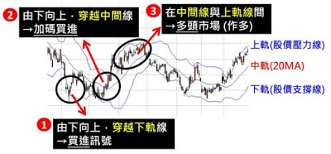
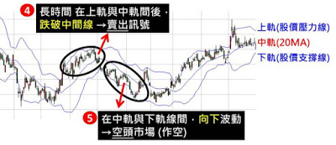
Background Knowledge http://www.sharetisfy.com/2018/01/blog-post_392.html http://www.aastocks.com/sc/education/execution_skill.aspx
线形图、柱状图、阴阳烛图显示股价走势，并应用多种技术指标（成交量、布历加通道、随机指数K/D、强弱指数RSI及汇聚分散移动平均数MACD）
上涨的訊號有三個: 1.价格由下往上，穿越下軌線時 可以准备进场。 2.价格由下往上，穿越中間線時 股價可能加速向上，是加碼買進訊號 3.价格在 中間線 與 上軌線之間 波動為多頭市場，可以买进。
空頭號有兩個: 4. 价格在 中間線與上軌線間 由上往下跌破中間線，准备逃，不然等住套房。 5. 价格在 中間線與下軌線之間 向下波動時為空頭市場，股票多数是跌的。

Slide 49
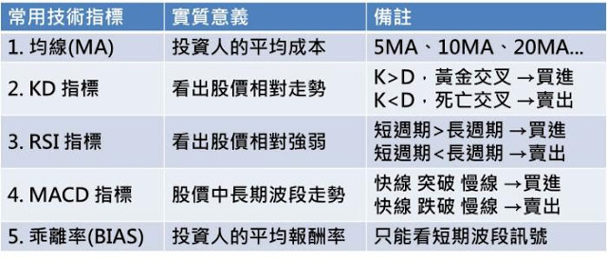
Background Knowledge http://www.sharetisfy.com/2018/01/blog-post_392.html http://www.aastocks.com/sc/education/execution_skill.aspx
1.均線 MA（Moving Average）是什么？怎样用？ MA 你可以理解为平均走势。 MA反映投資人的平均成本，比如5天，20天，90天的平均购买价格， *简单来说，假設今天股价高於 5 日線，就代表過去 5 天进场的人都是赚钱的。 *EMA（Exponential Moving Average）指数移动平均指标,也叫EXPMA指标。

Slide 50
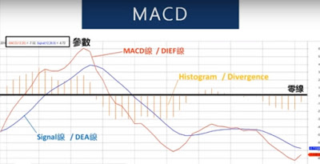
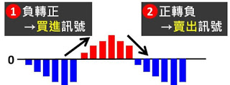
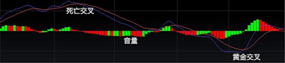
Background Knowledge http://www.sharetisfy.com/2018/01/blog-post_392.html http://www.aastocks.com/sc/education/execution_skill.aspx
2.MACD （Moving Average Convergence Divergence)指标是什么？怎样用？ MACD 是指数平滑異同移动平均线。用来判断目前的趋势买卖的强弱讯号，比如买方强劲数值会往上，卖方强势那么数值就会往下。 这个很好用，简单就可以看出目前的买卖趋势（可以自己调整），找出买卖点。高过0 代表目前买的人多，低过0代表卖的人多。
红色代表短线/MACD线/DIEF线，蓝色代表长线/Signal 线/DEA 线， 黄金交叉（进场时机） *当红色升穿过蓝色代表黄金交叉（进场时机）， 死亡交叉（卖出时机） *当红色跌穿过蓝色代表死亡交叉（卖出时机）。
Histogram/Divergence 音量（青红色） 全哥建议你可以理解为音量调高越多人买进，音量调低就越多人卖出。

Slide 51
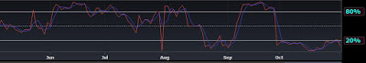
Background Knowledge http://www.sharetisfy.com/2018/01/blog-post_392.html http://www.aastocks.com/sc/education/execution_skill.aspx
3.KD 指标是什么？怎样用？ KD 是随机指标 Stochastic oscillator 是技术分析中的一种动量分析方法，采用超买和超卖的概念， 由乔治·莱恩（George C. Lane）在1950年代推广使用。 KD是由K值和D值这两个数值组成（会看到两条蓝红线）， 他能看出股价的涨跌的延續性，如继续涨，跌，或停止跌等等。
*KD大於80時，高处不胜寒，市场过热，股价开始要跌了。 *KD小於20時，逢低见机会，市场过冷，股价开始要起了。

Slide 52
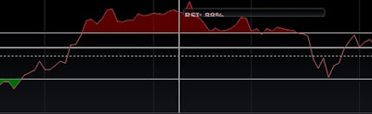
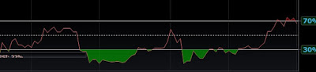
Background Knowledge http://www.sharetisfy.com/2018/01/blog-post_392.html http://www.aastocks.com/sc/education/execution_skill.aspx
4.RSI （Relative Strength Index）指标是什么？怎样用？ RSI 指标是用来判断股价跌涨的几率，也可以叫强弱指标。 用某段时间，股价平均涨幅和跌幅来计算的数值。 *RSI 的范围一定在 0-100 之間。 *RSI 越大，代表過去『漲的几率』越大。(如果漲和跌的几率一樣，RSI会是中間值50)
*线条上面累计的红色你可以理解为很多人市场非常的兴奋中（很多人赚钱，股价上升）参考MAGNI（7087）
*线条下面累计的青色你可以理解为很多人跳海（很多人亏钱，股价下跌) 参考TAMBUN （5191）
注：一般大于80%代表市场过热，要准备下跌了，小于20%代表市场过冷，开始要上升了。

Slide 53
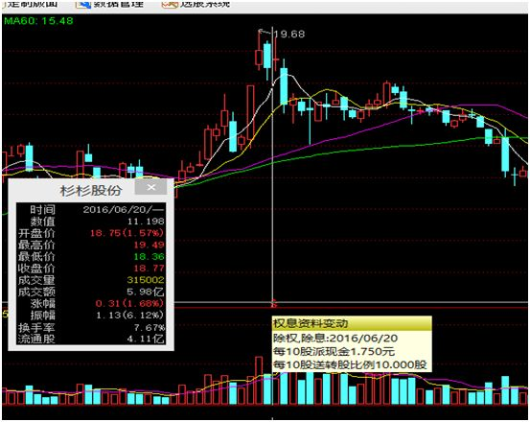
Background Knowledge https://www.zhihu.com/question/31004373
除权和复权
除权：假设某公司的总股本100股，每股10元，总权益就是1000元。当公司进行送股，每10股转送10股，总股本就变成了200股，而公司的总权益并没有变，于是每股价格就要变成1000/200=5元。这就是除权。
复权：当股价因送股、配股等原因而发生下跌时，原来10元/股的股票瞬间变成了5元/股，但该股票实际价值并没有发生变化，也就是说现在的5元实际上还是相当于10元。这就是复权。
不复权：当股价因送股等原因发生变化，在K线走势图上就有可能形成断崖式的下跌，比如从10元/股变为5元/股，当日的涨跌幅就变成了-50%.而实际上该股票的价值并没有发生重大变化，
复权又分为前复权和后复权。
前复权：以除权后第一天的价格点为基础把除权以前的数据进行复权。
假设10元/股因除权等原因变为了5元/股，并且除此之外，当天股价没有其他涨跌幅的变化，那进行前复权以后，K线图显示的就是，当天与前一天的股价都是5元，之前的股价也都一律按比例缩小，变为一条连续的曲线。

Slide 54
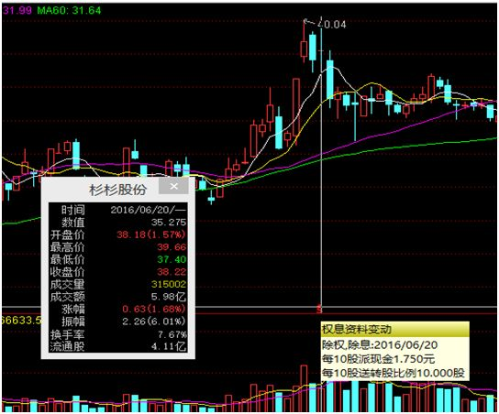
Background Knowledge https://www.zhihu.com/question/31004373
除权和复权
后复权：以除权前最后一天的价格点为基础把除权后的数据进行复权。
假设10元/股因除权等原因变为了5元/股，并且除此之外，当天股价没有其他涨跌幅的变化，那进行后复权以后，K线图显示的就是，当天与前一天的股价都是10元，之后的股价也都一律按比例放大，变为一条连续的曲线。

Slide 55
Background Knowledge
get_k_data含义是获取k线数据，新接口融合了get_hist_data和get_h_data两个接口的功能，即能方便获取日周月的低频数据，也可以获取5、15、30和60分钟相对高频的数据。
get_h_data() and get_hist_data() reports “vol (成交量)” 和”总量(amount)”. 股市中的成交量就是某只股票在一段时间内，买方买进了多少股(或者说是卖方卖出了多少股)，以单边的交易来计算。例如，某只股票当日成交量显示为9000股=90手(其中1手=100股)，这是表示买卖双方达成协议共交易了9000股，即买方买进了9000股，同时卖方卖出了9000股。在计算成交量时按9000股来统计。但如果计算交易量，则双边计算，买方9000股加卖方9000股，当日交易量计为18000股。
什么是成交额(AMOUNT)?“成交额”就是某只股票每笔成交股数乘以成交价格的金额总和。
对于一般个股来讲，如果股价变动幅度很大，用成交的股票数量(即个股成交量)或换手率就难以反映出主力资金的进出情况，而用成交额就能比较准确地反映出这一情况。

Slide 56
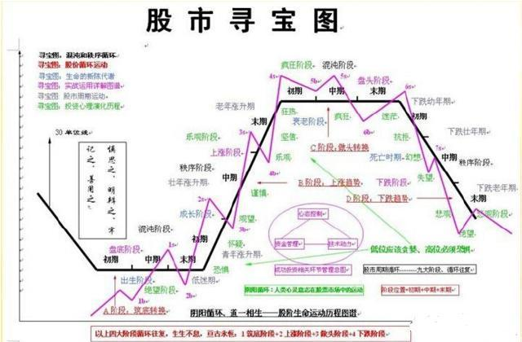
https://read01.com/nzDg8Q.html
http://blog.csdn.net/Eric2016_Lv/article/details/53886342
https://libraries.io/github/bsknight/pyalgotrade-cn
问题的本质：
非线性回归
成交量与股价如何归一化
如何用模型来提炼出左图的回归模型
在归一化的基础上，找出从2015年到现在的活跃股票

Slide 57
Background Knowledge
Python 变量作用域
L （Local） 局部作用域
E （Enclosing） 闭包函数外的函数中
G （Global） 全局作用域
B （Built-in） 内建作用域
以 L –> E –> G –>B 的规则查找，即：在局部找不到，便会去局部外的局部找（例如闭包），再找不到就会去全局找，再者去内建中找。
Python除了def/class/lambda 外，其他如: if/elif/else/ try/except for/while并不能改变其作用域。定义在他们之内的变量，外部还是可以访问。
ex: if True:
a = 'I am A'
......
print a
在 def/class/lambda内进行赋值，就变成了其局部的作用域，局部作用域会覆盖全局作用域，但不会影响全局作用域。
ex: g = 1 # Global Var
def fun():
g = 2 # Local Var
return g
print fun()
print g
在函数内部引用全局的变量，在函数内部添加 globals var.

Slide 58
Background Knowledge
闭包Closure
闭包的定义：如果在一个内部函数里，对在外部函数内（但不是在全局作用域）的变量进行引用，那么内部函数就被认为是闭包(closure)
Python类变量与成员变量
python 的类中，主要会使用的两种变量：类变量与成员变量。类变量是类所有实例化对象共有的，而成员变量是每个实例化对象自身特有的.
a、全局变量：在模块内、在所有函数外面、在class外面，这就是全局变量。
b、局部变量：在函数内、在class的方法内（未加self修饰的），这就是局部变量
c、 静态变量：在class内的，但不在class的方法内的，这就是静态变量
d、 实例变量：在class的方法内的，用self修饰的变量，这就是实例变量
class A(object):
def __init__(self):
#aa为成员变量
self.aa = 10
@staticmethod
def test(self):
self.aa += -1
if __name__ == '__main__':
x = A()
y = A()
#调用x
x.test(x)
print x.aa #输出9
y.test(y)
print x.aa #输出9
print y.aa #输出9
class A(object):
#aa为类变量
aa = 10
@staticmethod
def test(self):
A.aa += -1
if __name__ == '__main__':
x = A()
y = A()
x.test(x)
print x.aa #输出9
y.test(y)
print x.aa #输出8
print y.aa #输出8

Slide 59
Background Knowledge
闭包Closure
闭包的定义：如果在一个内部函数里，对在外部函数内（但不是在全局作用域）的变量进行引用，那么内部函数就被认为是闭包(closure)
闭包是由函数和与其相关的引用环境组合而成的实体.
闭包避免了使用全局变量，此外，闭包允许将函数与其所操作的某些数据（环境）关连起来。这一点与面向对象编程是非常类似的，在面对象编程中，对象允许我们将某些数据（对象的属性）与一个或者多个方法相关联。
简述 __init__、__new__、__call__ 方法
任何事物都有一个从创建，被使用，再到消亡的过程，在程序语言面向对象编程模型中，对象也有相似的命运：创建、初始化、使用、垃圾回收，不同的阶段由不同的方法（角色）负责执行。
定义一个类时，大家用得最多的就是 __init__ 方法，而 __new__ 和 __call__ 使用得比较少，这篇文章试图帮助大家把这3个方法的正确使用方式和应用场景分别解释一下。
__init__方法负责对象的初始化，系统执行该方法前，其实该对象已经存在了，要不然初始化什么东西呢？
__new__ 方法的返回值就是类的实例对象，这个实例对象会传递给 __init__ 方法中定义的 self 参数，以便实例对象可以被正确地初始化。
如果 __new__ 方法不返回值（或者说返回 None）那么 __init__ 将不会得到调用，这个也说得通，因为实例对象都没创建出来，调用 init 也没什么意义，此外，Python 还规定，__init__ 只能返回 None 值，否则报错，
__init__方法中除了self之外定义的参数，都将与__new__方法中除cls参数之外的参数是必须保持一致或者等效。
__new__ 方法 (单例模式)
class BaseController(object):
_singleton = None
def __new__(cls, *a, **k):
if not cls._singleton:
cls._singleton = object.__new__(cls, *a, **k)
return cls._singleton

Slide 60
Background Knowledge
__call__ 方法
关于 __call__ 方法，不得不先提到一个概念，就是可调用对象（callable），我们平时自定义的函数、内置函数和类都属于可调用对象，但凡是可以把一对括号()应用到某个对象身上都可称之为可调用对象，判断对象是否为可调用对象可以用函数 callable,实例对象也可以像函数一样作为可调用对象来用，那么，这个特点在什么场景用得上呢？这个要结合类的特性来说，类可以记录数据（属性），而函数不行（闭包某种意义上也可行），利用这种特性可以实现基于类的装饰器，在类里面记录状态.
Python多线程编程
创建线程的方式有两种:
1)继承threading.Thread
a.创建一个threading.Thread的子类
b.覆盖__init__(self [,args])
c.重写run方法
2)任务函数作为参数传递到Thread方法中
threading.Thread(target=task, args=()).start()
#!/usr/bin/python
#!coding=utf-8
import threading
import time
exitFlag = 0
class MyThread(threading.Thread):
def __init__(self, threadID, name, counter):
threading.Thread.__init__(self)
self.threadID = threadID
self.name = name
self.counter = counter
def run(self):
task()
def task(self):
'''线程要执行的任务'''
print 'starting ' + self.name
print 'exiting ' + self.name
#创建线程
thread1 = MyThread(1,'Thread-1', 1)
thread2 = MyThread(2,'Thread-2', 2)
#启动线程
thread1.start()
thread2.start()
#等待线程结束
thread1.join()
thread2.join()
print 'exiting main thread'

Slide 61
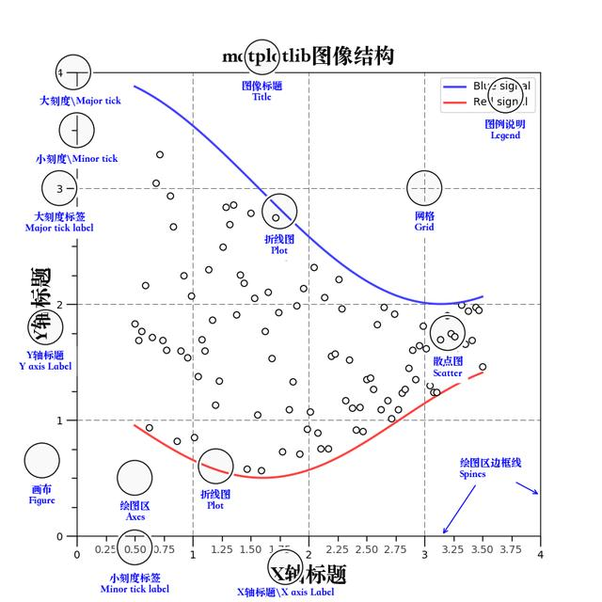
Matplotlib https://www.wukong.com/question/6490129780799701262/
通常情况下，我们可以将一副Matplotlib图像分成三层结构：
第一层是底层的容器层，主要包括Canvas、Figure、Axes；
第二层是辅助显示层，主要包括Axis、Spines、Tick、Grid、Legend、Title等，该层可通过set_axis_off()或set_frame_on(False)等方法设置不显示；
第三层为图像层，即通过plot、contour、scatter等方法绘制的图像。
Figure是Canvas上方的第一层，也是需要用户来操作的应用层的第一层，在绘图的过程中充当画布的角色。当我们对Figure大小、背景色彩等进行设置的时候，就相当于是选择画布大小、材质的过程。因此，每当我们绘图的时候，写的第一行就是创建Figure的代码。
Axes是应用层的第二层，在绘图的过程中相当于画布上的绘图区的角色。一个Figure对象可以包含多个Axes对象，每个Axes都是一个独立的坐标系，绘图过程中的所有图像都是基于坐标系绘制的。

Slide 62
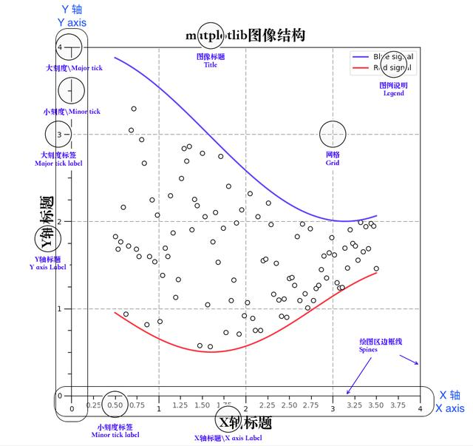
Matplotlib https://www.wukong.com/question/6490129780799701262/
辅助显示层
辅助显示层为Axes内的除了根据数据绘制出的图像以外的内容，主要包括Axes外观(facecolor)、边框线(spines)、坐标轴(axis)、坐标轴名称(axis label)、坐标轴刻度(tick)、坐标轴刻度标签(tick label)、网格线(grid)、图例(legend)、标题(title)等内容。
该层的设置可使图像显示更加直观更加容易被用户理解，但又并不会对图像产生实质的影响。
图像层
图像层指Axes内通过plot、scatter、hist、contour、bar、barbs等函数根据数据绘制出的图像。

Slide 63
Matplotlib
﻿matplotlib API包含有三层：
backend_bases.FigureCanvas : 图表的绘制领域
backend_bases.Renderer : 知道如何在FigureCanvas上如何绘图
artist.Artist : 知道如何使用Renderer在FigureCanvas上绘图
﻿FigureCanvas和Renderer需要处理底层的绘图操作。
Artist则处理所有的高层结构，例如处理图表、文字和曲线等的绘制和布局。
通常我们只和Artist打交道，而不需要关心底层的绘制细节。
﻿Artists分为简单类型和容器类型两种。
简单类型的Artists为标准的绘图元件，例如Line2D、 Rectangle、 Text、AxesImage 等。
容器类型则可以包含许多简单类型的Artists，使它们组织成一个整体，例如Axis、 Axes、Figure等。
﻿直接使用Artists创建图表的标准流程如下：
创建Figure对象
用Figure对象创建一个或者多个Axes或者Subplot对象
调用Axies等对象的方法创建各种简单类型的Artists
﻿在构成图表的各种Artist对象中，最上层的Artist对象是Figure。我们可以调用add_subplot()与add_axes(）方法向图表中添加子图，它们分加到figure的axes的属性列表中。

Slide 64
Matplotlib
基本用法
﻿plt.subplot(2, 2, 4)
plt.plot(x2, y2, 'r.-')
plt.xlabel('time (s)')
plt.ylabel('Undamped')
plt.show()
axes 容器
它是整个matplotlib的核心，它包含了组成图表的众多的artist对象。并且有很多方法。我们常用的Line2D啦，Xaxis，YAxis等都是它的属性哦；可以通过这个对象的属性来设置坐标轴的label啦，范围啦等之类的。干脆直接用plt.getp()查看它的属性，然后通过set_属性名（）函数来设置就好啦。
axis 容器
axis容器包括了坐标轴上的刻度线、刻度标签等、坐标网络等内容。
常用函数
plot()
可以画出很简单线图
﻿subplot()
利用subplot()函数可以返回一个axes的对象哦，函数为：subplot(numRows, numCols, plotnum)
subplots()
﻿plt.subplots(nrows=1, ncols=1, sharex=False, sharey=False, squeeze=True, subplot_kw=None, **fig_kw)
﻿nrows : int ,指创建的subplots的行数,默认为1. ncols : int ,指创建的subplots的列数,默认为1. sharex : 为一个string或bool类型; 当为Ture时,所有的subpots将要共享x轴,如果它们是上下的关系的话,上面的图的刻度label就没有,只有下面那个图的.
﻿# subplots() 返回值
import matplotlib.pyplot as plt
import numpy as np
x = np.range(0,30,1)
y = np.sin(x)
# 接收返回的两个对象
f,(ax1, ax2) = plt.subplots(1, 2, sharey=True)
# 两个对象分别画图
ax1.plot(x, y)
ax1.set_title('Sharing Y axis')
ax2.scatter(x, y)
plt.show()
plt.subplots() is a function that returns a tuple containing a figure and axes object(s). Thus when using fig, ax = plt.subplots() you unpack this tuple into the variables fig and ax. Having fig is useful if you want to change figure-level attributes or save the figure as an image file later (e.g. with fig.savefig('yourfilename.png'). You certainly don't have to use the returned figure object .

Slide 65
Matplotlib
fig, ax = plt.subplots()
is more concise than this:
fig = plt.figure()
ax = fig.add_subplot(111)
﻿twinx()或twiny()
twinx()：在同一图画中，共享x轴，但是拥有各自不同的y轴.
﻿# twinx() 共享x轴实例
import matplotlib.pyplot as plt
import numpy as np
fig = plt.figure(1)
ax1 =plt.subplot(111)
ax2 = ax1.twinx()
ax1.plot(np.arange(1,5),'g--')
ax1.set_ylabel('ax1',color = 'r') ax2.plot(np.arange(7,10),'b-')
ax2.set_ylabel('ax2',color = 'b')
plt.show()
Numpy 知识点：
http://blog.csdn.net/sinat_32547403/article/details/54017551
Scikit-Learn 知识点：
http://lib.csdn.net/article/machinelearning/34918

Slide 66
Numpy Usage
a = np.array([[1, 2, 3, 4, 5], [6, 7, 8, 9, 10]])
Create by function a = np.arange(begin, end, stepSize)
a = np.linspace(begin, end, nbSampleData)
a = np.logspace(begin, end, nbSampleData)
a = np.ones((numOfRow, numOfCol))
a = np.zeros((numOfRow, numOfCol))
a = np.eye(orderNumber)
a = np.empty((numOfRow, numOfCol))
a = np.fromstring(“exampleString”, dtype=np.int8)
a = np

Slide 67
https://zhuanlan.zhihu.com/p/23471979
https://zhuanlan.zhihu.com/p/23665565
http://blog.csdn.net/niuge8905/article/details/78287355
Tick Data Usage:
https://www.zhihu.com/question/26950456如何用TICK数据生成分钟线数据:
https://mp.weixin.qq.com/s?__biz=MzAwOTgzMDk5Ng==&mid=2650833965&idx=1&sn=e3e74639c068e7a1e41a35bb1decd313&chksm=80adb316b7da3a00de4191d4da6a5a7cab60fa3d282876fcf0b4d6dd8fc234528a316f5aa50a&mpshare=1&scene=1&srcid=090514fJTxEaB4CbnBI85x60&pass_ticket=qA7MkXEYQz2xA0uHwCD8eF43XfYsQMFMTyDT0euW7YFDRhLeVPR8dAxIaK6gxprk#rd
Low Priorities:
https://www.ricequant.com/api/python/chn#what-is-ricequantTA-Lin
http://mrjbq7.github.io/ta-lib/funcs.html
Quantitative Trading Python Library
https://pypi.python.org/pypi/QTPyLibExamples
https://www.ricequant.com/community/topic/4786/
https://www.ricequant.com/community/topic/174//22?page=2Jupyter Notebook Usage:
https://www.zhihu.com/question/59392251
Reinforcement Learning Example
https://zhuanlan.zhihu.com/p/33344668

Slide 68
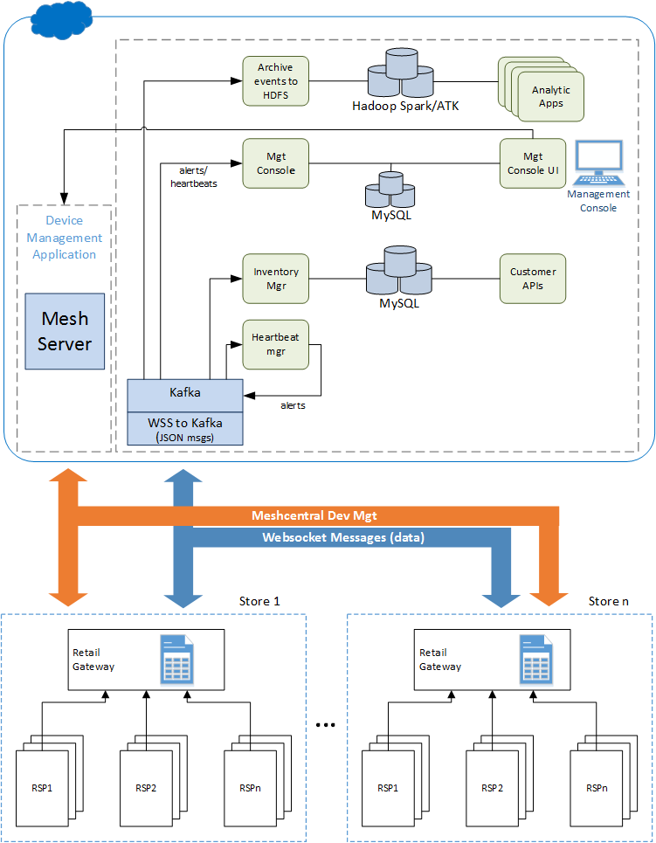
RFID Architecture Diagram

Slide 69
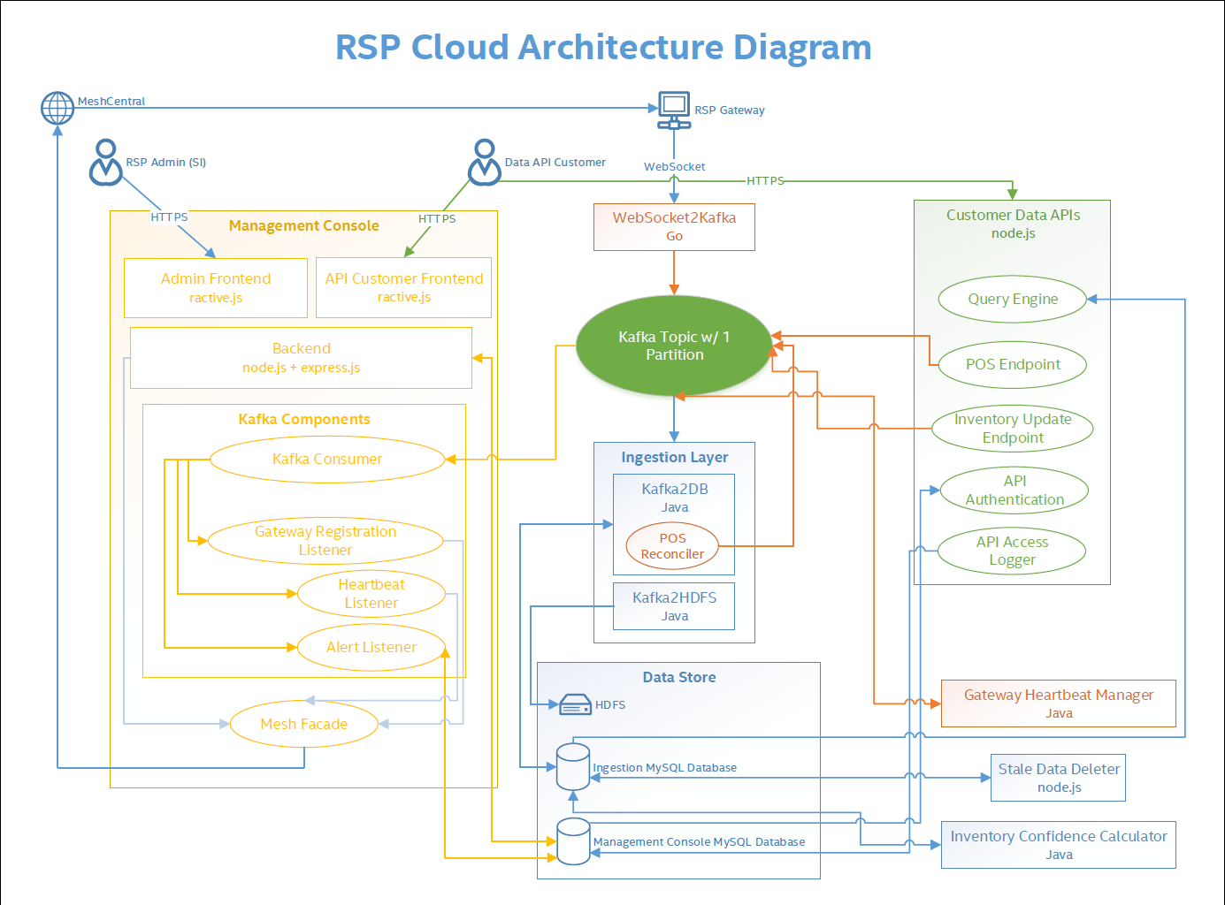

Slide 70
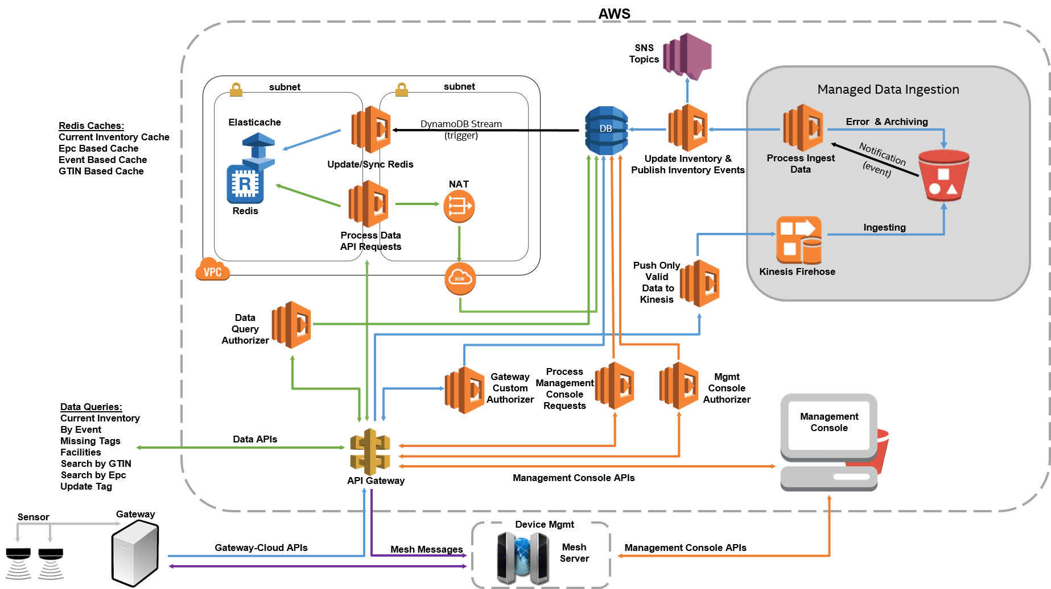

Slide 71
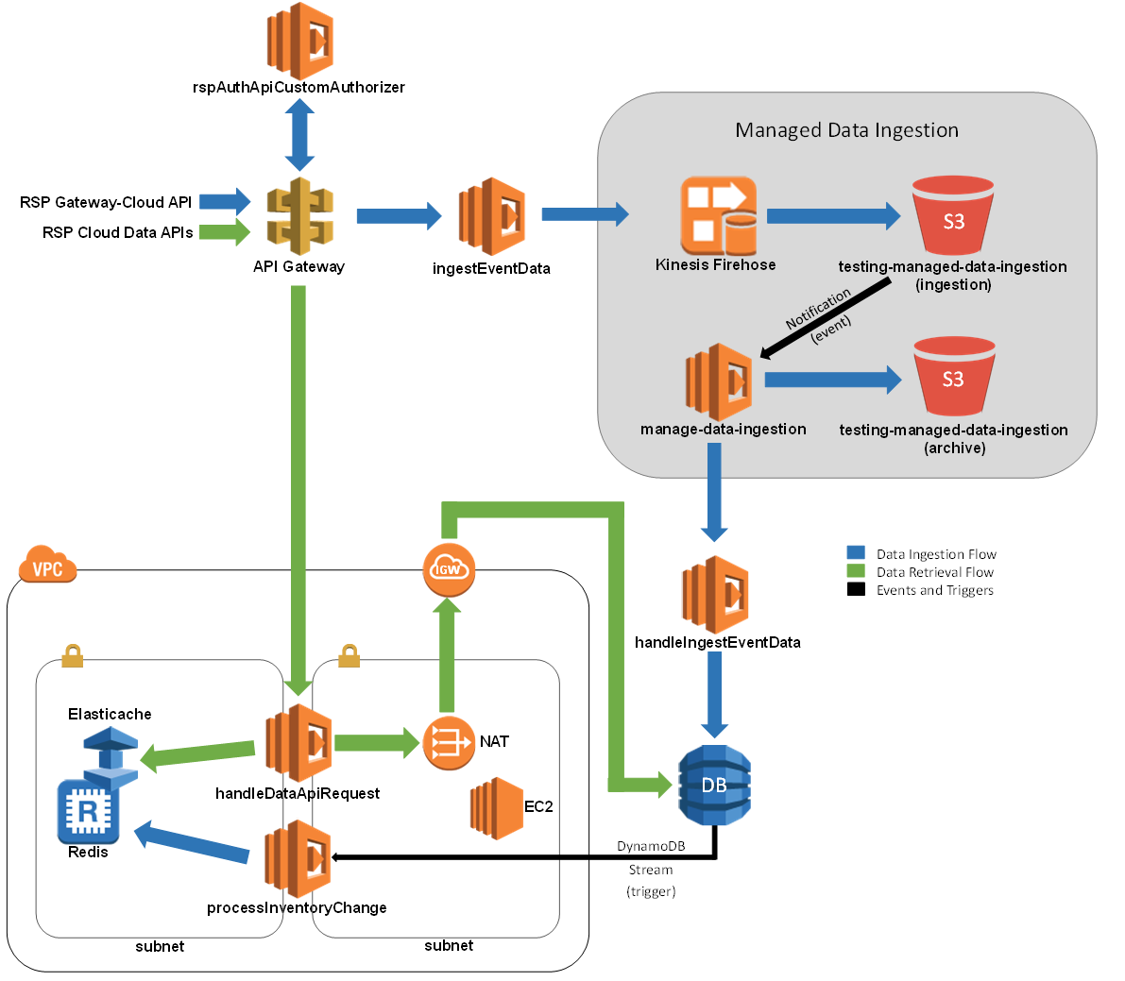
AWS Input Pipeline Overview
http://docs.aws.amazon.com/lambda/latest/dg/with-s3.html
http://docs.aws.amazon.com/amazondynamodb/latest/developerguide/Streams.Lambda.html

Slide 72
zkSnark
A要向B证明自己拥有某个房间的钥匙，假设该房间只能用钥匙打开锁，而其他任何方法都打不开。这时有2个方法：
②B确定该房间内有某一物体，A用自己拥有的钥匙打开该房间的门，然后把物体拿出来出示给B，从而证明自己确实拥有该房间的钥匙。
A拥有B的公钥，A没有见过B，而B见过A的照片，偶然一天两个人见面了，B认出了A，但A不能确定面前的人是否是B，这时B要向A证明自己是B，也有2个方法。
② A给出一个随机值，并使用B的公钥对其加密，然后将加密后的数据交给B，B用自己的私钥解密并展示给A，如果与A给出的随机值相同，则证明对方是B。

Slide 73
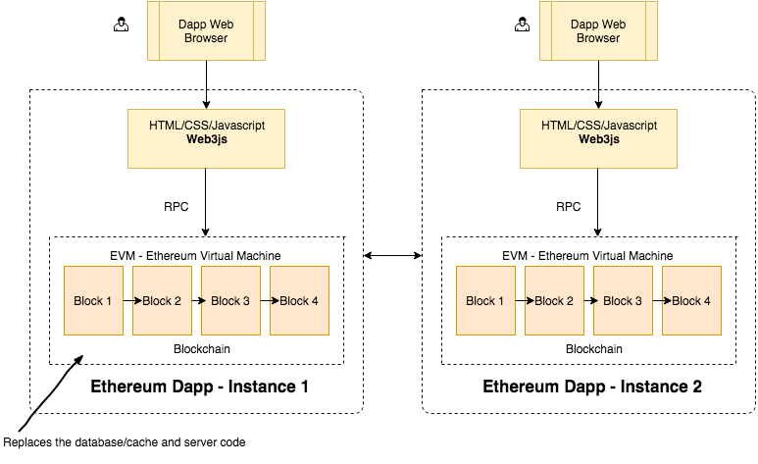
Dapp High Level Model https://medium.com/@mvmurthy/ethereum-for-web-developers-890be23d1d0c

Slide 74
Ethereum Development Environment
Ganache: ﻿in- memory blockchain (think of it as a blockchain simulator). “npm install ganache-cli web3@0.20.2”
Solidity compiler: npm install solc
Javascript code to connect blockchain:
﻿> Web3 = require('web3')
> web3 = new Web3(new Web3.providers.HttpProvider("http://localhost:8545"));
﻿> contractInstance.totalVotesFor.call('Rama'){ [String: '0'] s: 1, e: 0, c: [ 0 ] }
> contractInstance.voteForCandidate('Rama', {from: web3.eth.accounts[0]})'0xdedc7ae544c3dde74ab5a0b07422c5a51b5240603d31074f5b75c0ebc786bf53‘
> contractInstance.voteForCandidate('Rama', {from: web3.eth.accounts[0]})'0x02c054d238038d68b65d55770fabfca592a5cf6590229ab91bbe7cd72da46de9‘
> contractInstance.voteForCandidate('Rama', {from: web3.eth.accounts[0]})'0x3da069a09577514f2baaa11bc3015a16edf26aad28dffbcd126bde2e71f2b76f'
> ontractInstance.totalVotesFor.call('Rama').toLocaleString()
'3'
﻿> code = fs.readFileSync('Voting.sol').toString() > solc = require('solc') > compiledCode = solc.compile(code)
﻿> abiDefinition = JSON.parse(compiledCode.contracts[':Voting'].interface) > VotingContract = web3.eth.contract(abiDefinition) > byteCode = compiledCode.contracts[':Voting'].bytecode > deployedContract = VotingContract.new(['Rama','Nick','Jose'],{data: byteCode, from: web3.eth.accounts[0], gas: 4700000}) > deployedContract.address > contractInstance = VotingContract.at(deployedContract.address)

Slide 75
Ethereum Development Environment
﻿Ethereum has a few public test blockchains and one main blockchain.
Testnet: There are a few test blockchains such as Ropsten, Rinkeby, Kovan. Think of these as a QA or a staging server, they are used for testing purposes only. All the Ether you use on these networks is fake.
Mainnet (also called Homestead): This is the blockchain which the entire world transacts on for real. There is real value to the Ether you use on this network.
﻿mahesh@projectblockchain:~/voting$ npm install -g webpack mahesh@projectblockchain:~/voting$ truffle unbox webpack mahesh@projectblockchain:~/voting$ ls README.md contracts node_modules test webpack.config.js truffle.js app migrations package.json

Slide 76
﻿Ethereum Dapp Development https://cn.zastrin.com/decentralized-ebay-on-ethereum-and-ipfs-syllabus
﻿Install geth — the client software used to download the blockchain and run the Ethereum node on your local machine.
Install the Ethereum dapp framework called Truffle which will be used for compiling and deploying our contract.
Make small updates to our Voting application to make it work using truffle.
Compile and deploy the contract to the Rinkeby testnet.
Interact with the contract through truffle console and then through a webpage.
﻿mahesh@projectblockchain:~$ geth --rinkeby --syncmode "fast" --rpc --rpcapi db,eth,net,web3,personal --cache=1024 --rpcport 8545 --rpcaddr 127.0.0.1 --rpccorsdomain "*"
﻿This will start the Ethereum node, connect to other peer nodes and start downloading the blockchain.
﻿When your blockchain is fully sync’d, the block number you see will be close to the block number on this page: https://rinkeby.etherscan.io/
﻿构建一个类似 eBay 的去中心化商场。你会构建一个智能合约，通过该合约，任何人都可以 列出他们先要在商场出售的产品。消费者可以 浏览产品 并 通过拍卖购买产品。你也会实现一个 托管服务，它会被买方和卖方用来保护交易，确保支付和产品交付。这个应用将会基于 Solidity 语言，truffle 框架，JavaScript 和 HTML/CSS 构建。IPFS 将会用于存储图片和大文本，MongoDB 将会用作链下的解决方案 来实现产品的搜索功能。几个关键库将会用于构建应用，其中包括了 web3js，ipfs-api 和 ethereumjs-util。

Slide 77
使用Parity建立Proof-of-Authority (PoA) Ethereum联盟链 https://medium.freecodecamp.org/python-collection-of-my-favorite-articles-8469b8455939 https://blog.csdn.net/fidelhl/article/details/55805638 https://blog.csdn.net/wo541075754/article/details/77505299 https://medium.com/@pipermerriam/the-python-ethereum-ecosystem-101bd9ba4de7
PoA Chain特点有
有别于PoW (Proof-of-Work)需要解数学难题来产生block，PoA是依靠预设好的Authority nodes，负责产生block。
可依照需求设定Authority node数量。
可指定产生block的时间，例如收到交易的5秒后产生block。
一般的Ethereum node也可以连接到PoA Chain，正常发起transactions, contracts等。
Parity是一个注重效能的Ethereum Client端软体

